Slide 1
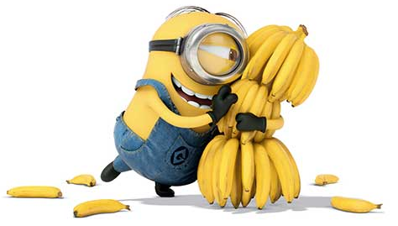

Lost Hope
Objective detection with the Arduino Nano 33 BLE w/ OV7675 camera
Anthony Samagaio, Aryan Gupta the Curry Man, Sam Xu the Great
https://github.com/AntTheToni
https://github.com/aryan-gupta/
https://github.com/ric3b0wl

Slide 2
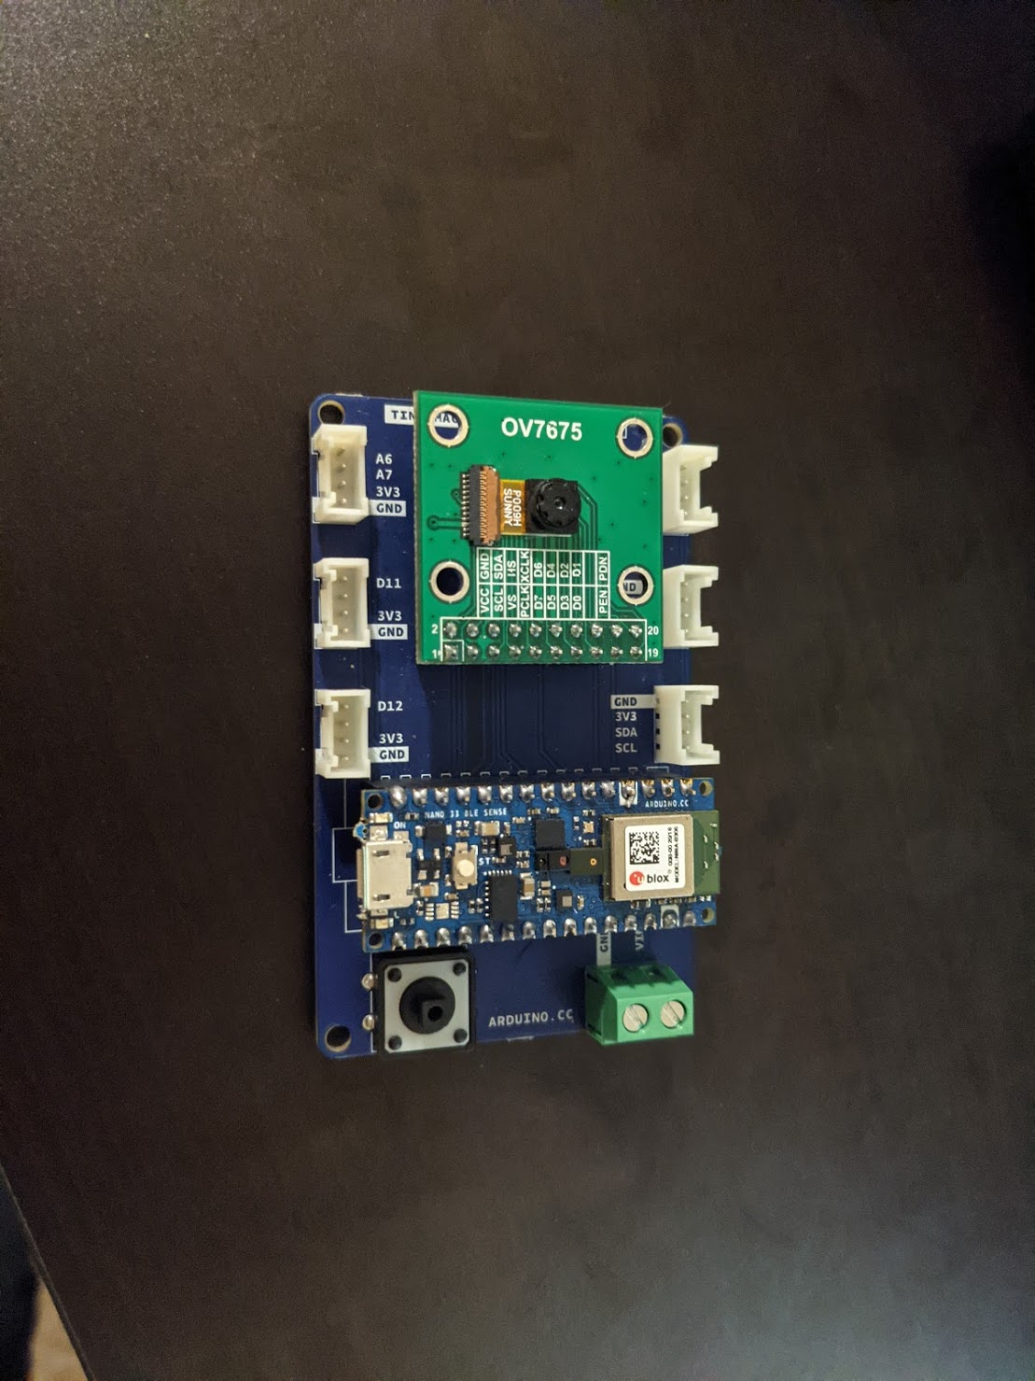
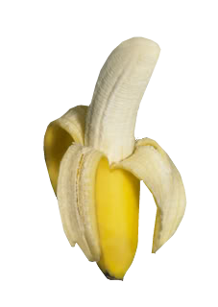
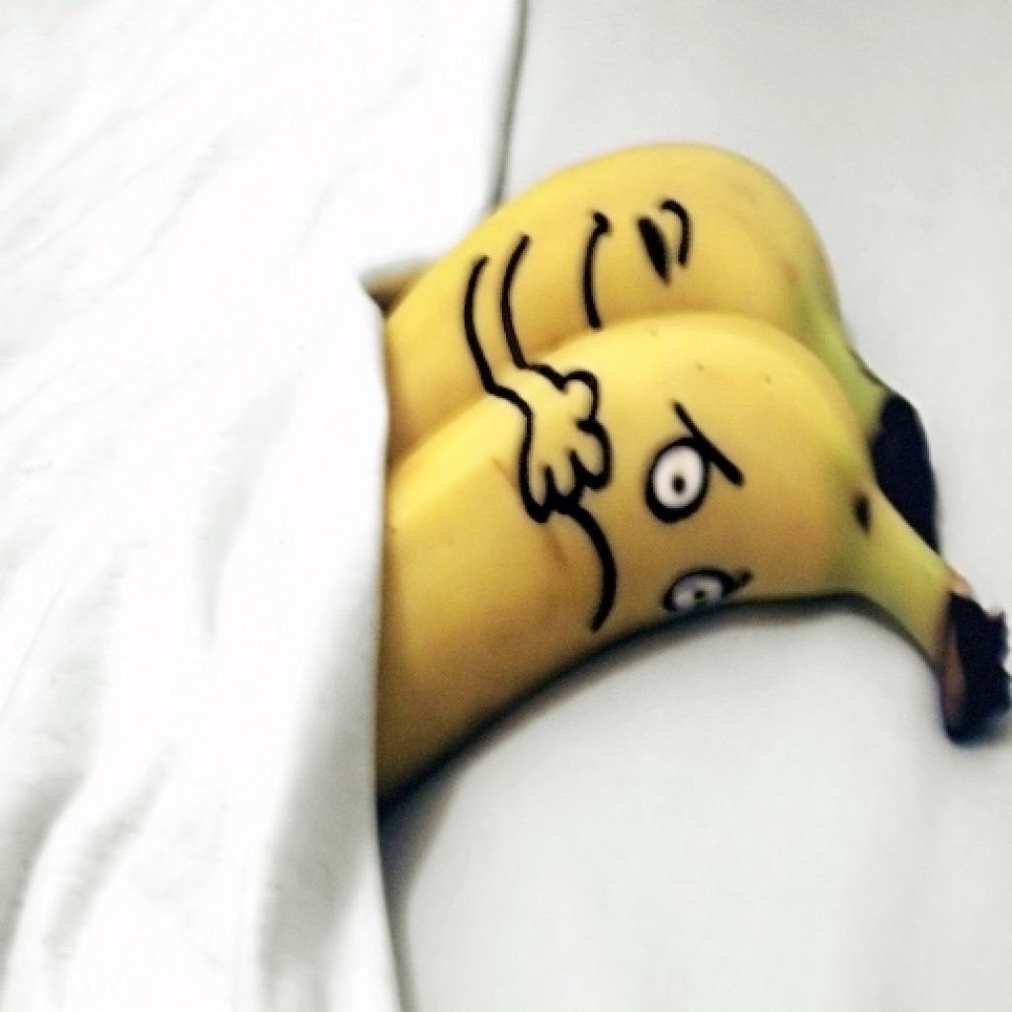
Introduction
The goal of the project was to train the model (Arduino Nano 33 ble) to detect a specific target using the Arduino camera.
The group chose the target “banana” and trained the model to detect a banana when presented to the camera.
Online images of bananas and real bananas were used to test the accuracy of model.

Slide 3
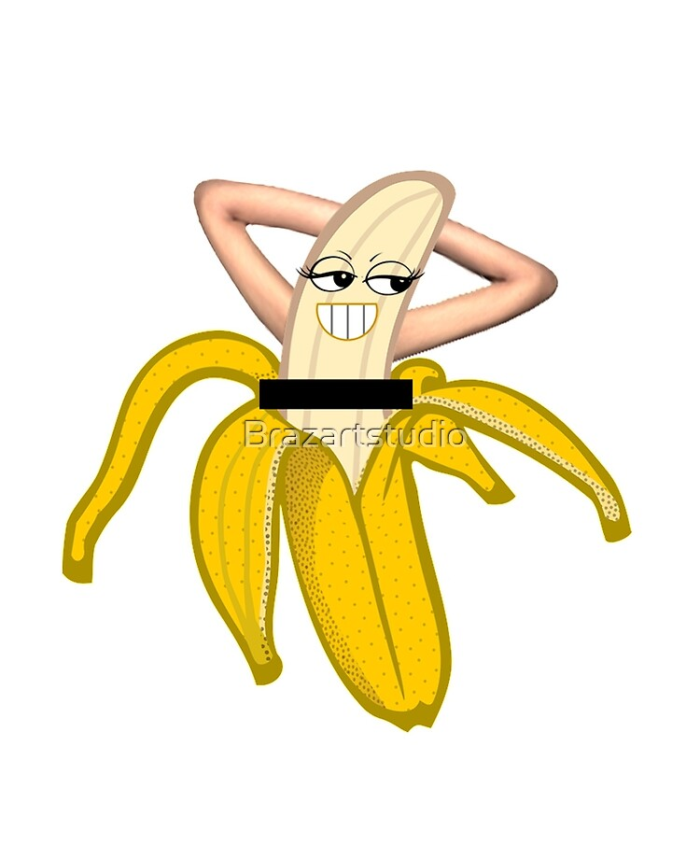
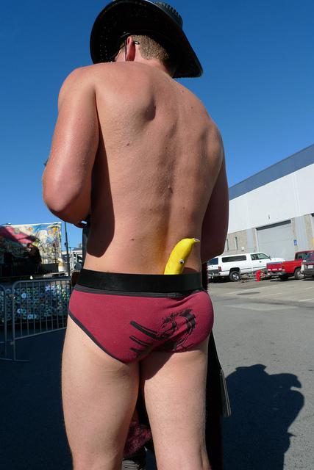
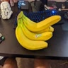

Data Collection
Coco
Fruits 360 Dataset (318 banana images)
Coco 2017 Dataset (1618 banana / 39,347 not banana images)
Custom Dataset (27,283 banana images)
Recorded ~6min video of bananas in various environments
Resized to 96x96 pixels
Split into individual frames
Total Banana: 29,219
Total Not Banana: 30,347
Custom
Fruit 360

Slide 4
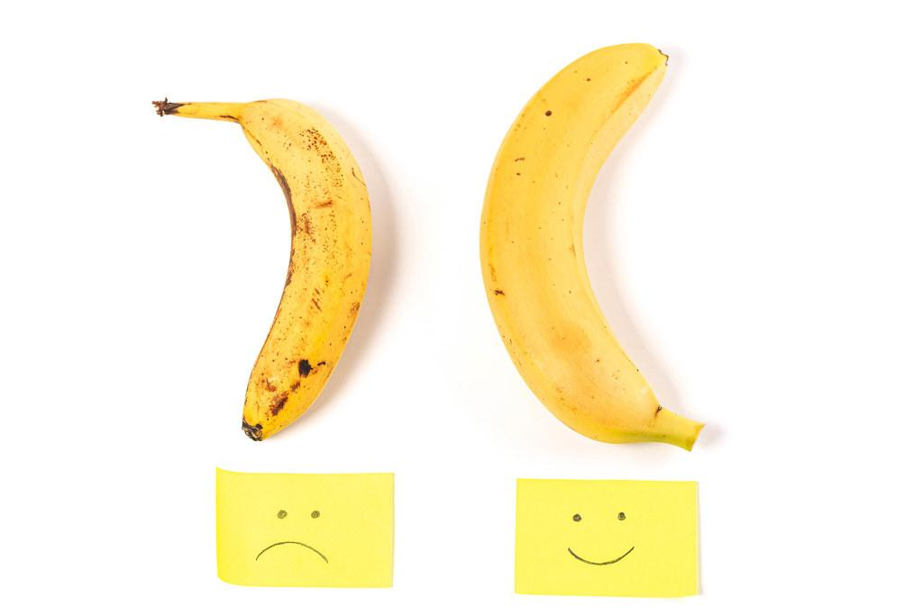
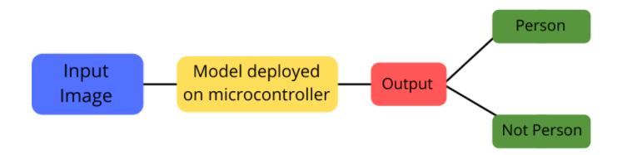
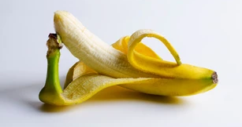
Training
mlcommons training script (visual wake words)
Mobile net v1
Google Colab
Training/Validation
epoch | loss | accuracy | val_loss | val_accuracy
15/100 | 0.0297 | 0.9954 | 0.6286 | 0.7919
100/100 | 0.0040 | 0.9999 | 2.5840 | 0.7280
Banana
Not Banana

Slide 5
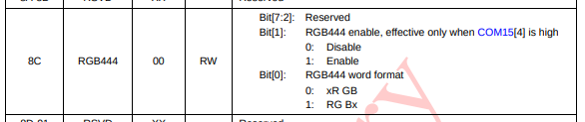
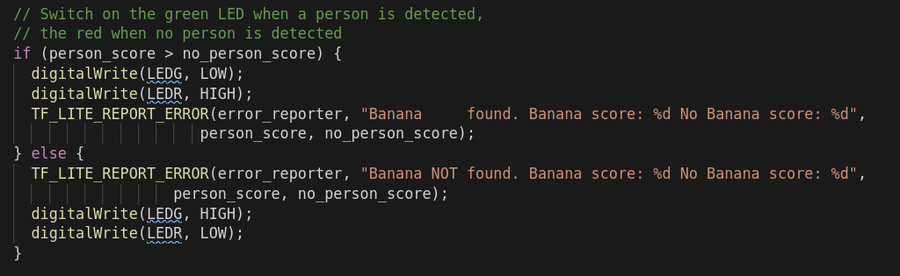

Microcontroller
Code based off of Harvard TinyML Person Detector Code
Works with RGB and Grayscale
Image is sent 5 times per second
Model is run ~once a second

Slide 6

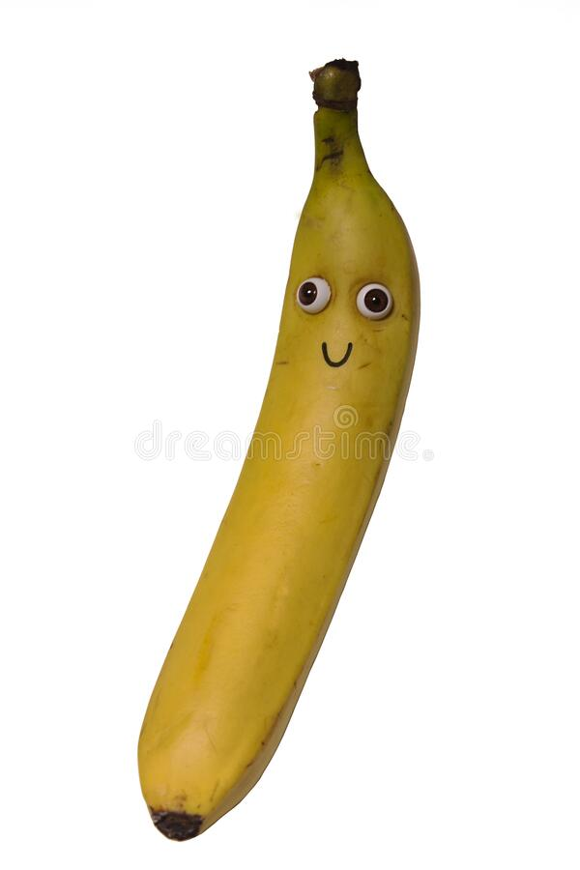
Video

Slide 7

Conclusion
Issues
Hard to find starting point
TensorFlowLite version was outdated
More data needed (model was overfitting)
Timing the upload with the reset button
Improvement ideas
More training data
Better accuracy with color (bananas are yellow)
More fruit models
Real world use cases
Groceries Notifier
Ripeness Detection (for grocery store restocking)

Slide 8
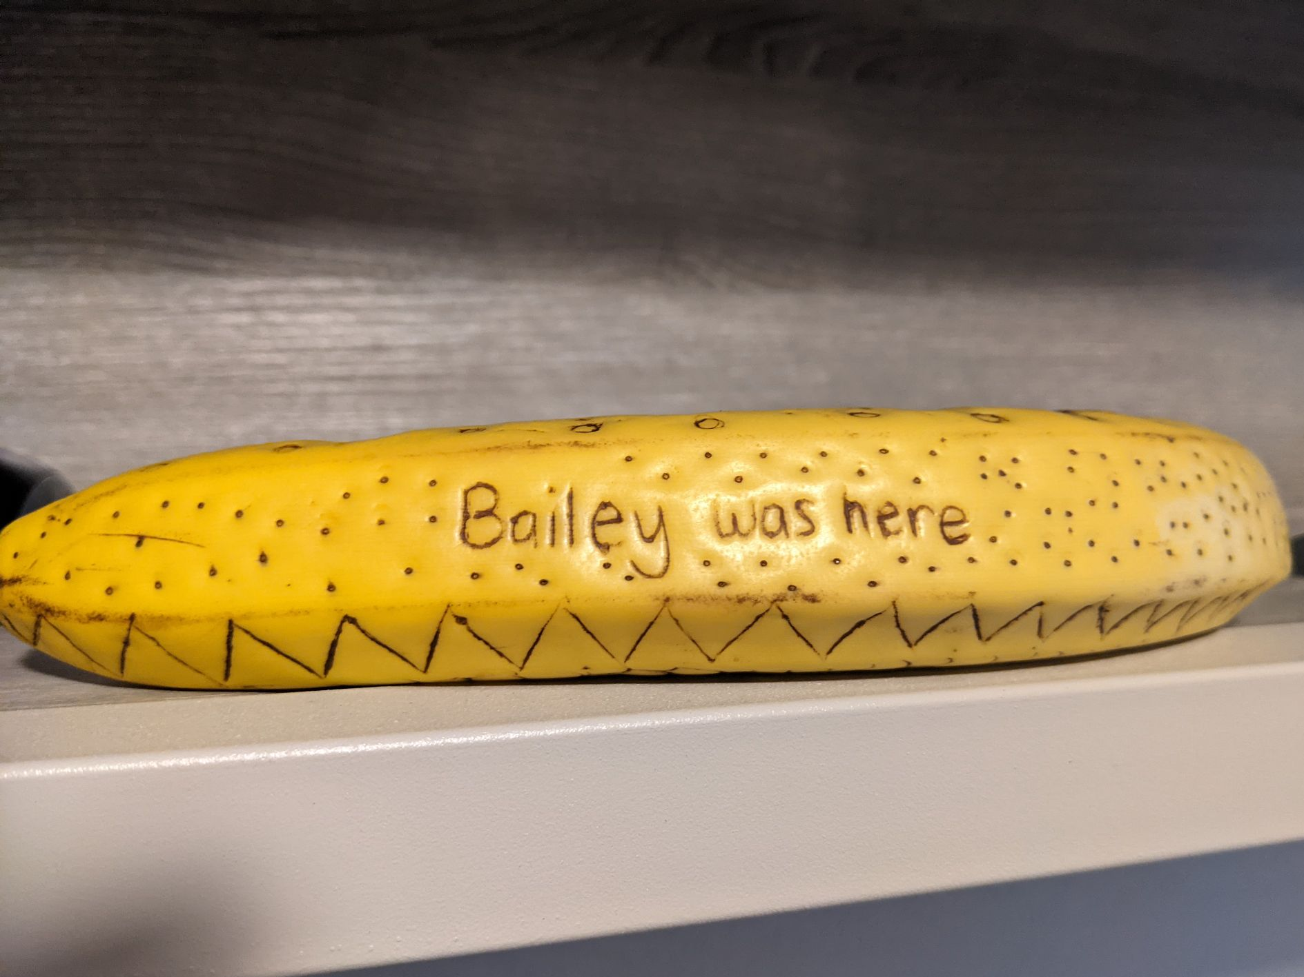
Questions?
How many Banana did you see in our slides?
No bananas were harmed during the completion of this project.
12

